Slide 2
Introduction
This pack is designed to help pupils think about the effects of discrimination or hurtful behaviour, while providing opportunities to challenge and change attitudes towards discrimination all within a real-life context. Pupils are encouraged to develop empathy and practise techniques to behave inclusively.

Slide 3
Introduction
This pack has been designed to suit any year group in Key Stage 2, enabling schools to decide where it best fits within their PSHE curriculum.
This lesson should take one hour.
The suggested timings are the minimum required to deliver the activities – see General guidance for teaching PSHE for more information.
The copyright of this content belongs to Premier League and as such edited content should not be shared more widely.

Slide 4
Pack structure
The activities in this pack have been designed to be taught as a structured PSHE education lesson, as part of your developmental programme of PSHE education.
The activities have been written by teachers to ensure they are as flexible as possible for teachers to use. Although activities have been designed to be taught sequentially, they are also flexible enough to be adapted according to your preferred teaching style and in a way best suited to your pupils.
Some activities give important information and further ideas in the notes section for more challenging or support options for tasks. Some slides are in ‘hidden view’ for teachers to access content not relevant to pupils. These are clearly marked with an icon.
Please also see the website for complementary classroom tools available for this pack such as our class planner, interactives and additional videos.

Slide 5
Important: Before teaching this pack
In accordance with best practice in PSHE education, you must create a safe learning environment in which pupils can explore the topics raised.
See the accompanying document General guidance for teaching PSHE for more information.
Discrimination is when someone is treated differently or unfairly because of their racial or ethnic origin, disability, religion or belief, age, sex or sexual orientation. Discrimination exists in all races and cultures and can be experienced by anyone. People can be discriminated against in different ways, for example not being allowed to join in an activity because of their gender.
It may be necessary to explain that people can be discriminated against because of their age, for example not being given a job because they’re deemed to be too old, but there are also age restrictions in order to protect children, on films or computer games for example, which isn’t an example of age discrimination.

Slide 6
Important: Before teaching this pack
It is possible that during discussions a pupil or pupils may express uncomfortable, discriminatory or extremist views. If this happens, challenge the attitudes rather than the person, and remind pupils that extremist attitudes are unacceptable in school. Pupils should not talk about personal experiences of discrimination but may choose to disclose during or after this lesson. You may need to report this to the person with responsibility for safeguarding in the school.

Slide 7
Curriculum links
PSHE Association Programme of Study for KS2 (England):
Core theme 1: Health and Wellbeing
H1. what positively and negatively affects their physical, mental and emotional health
Core theme 2: Relationships
R7. that their actions affect themselves and others
R14. to realise the nature and consequences of discrimination, teasing, bullying and aggressive behaviours… and ask for help
Core theme 3: Living in the Wider World
L1. to research, discuss and debate topical issues, problems and events that are of concern to them and offer their recommendations to appropriate people
L6. to realise the consequences of anti-social, aggressive and harmful behaviours such as bullying and discrimination of individuals and communities; to develop strategies for getting support for themselves or for others at risk

Slide 8
Curriculum links
Links to PSE framework KS2 (Wales):
PSE Active Citizenship
Learners should be given opportunities to: develop respect for themselves and others; value diversity and recognise the importance of equality of opportunity; understand situations which produce conflict and the nature of bullying.
PSE Working with others
Learners should be given opportunities to; resist unwanted peer pressure and behaviour; manage different emotions and develop strategies to resolve conflict and deal with bullying; ask for personal support and advice.

Slide 9
Learning objectives and outcomes
Learning Objectives:
Pupils will learn:
about the difference between discrimination and inclusion.
Learning Outcomes:
Pupils will be able to:
explain what is meant by inclusion, and discrimination
demonstrate an understanding of what inclusion and discrimination looks like
identify ways to challenge discrimination.

Slide 10
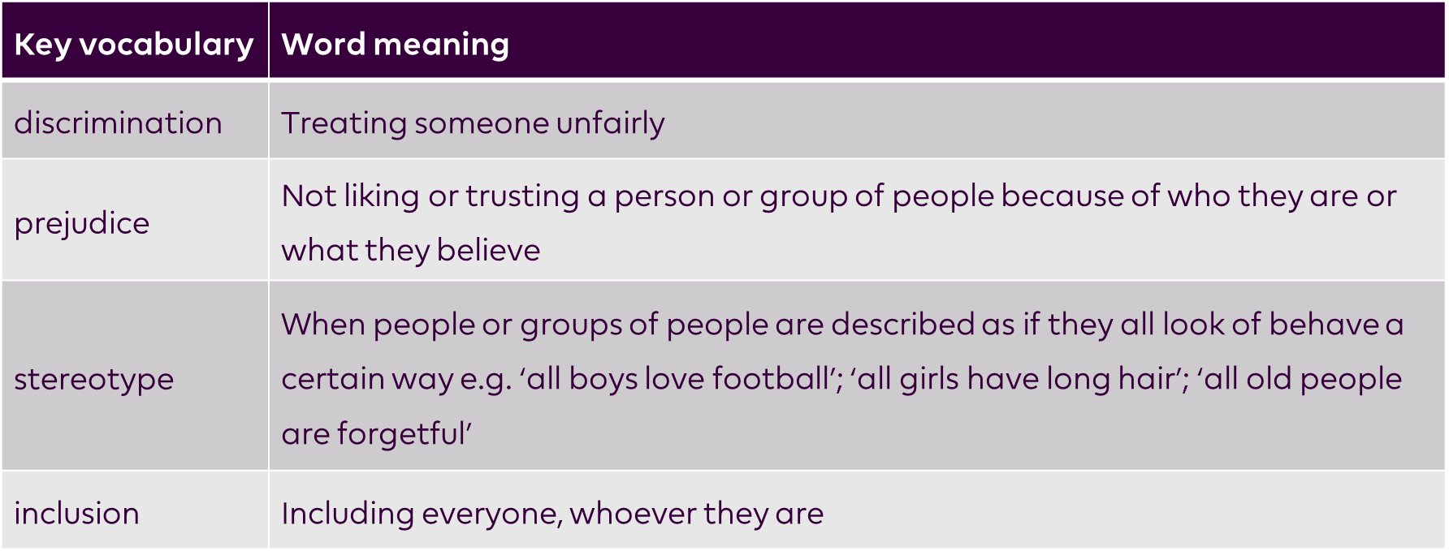
Word bank
Notes:
List of key vocabulary - clarifies meanings of the words and phrases in the context of the pack’s objectives and outcomes.
Teachers may find it useful to use with younger pupils, or with those who need additional help with understanding the concepts.

Slide 11
Diversity
Lesson 1
PSHE Resource
Key Stage 2

Slide 12
Starter activity: Understanding language
Activity summary
The first activity is a baseline assessment, designed for teachers to identify pupils’ starting point.
Each pupil considers what is meant by discrimination and inclusion. Pupils then watch a short film and discuss what they think about discrimination.
Approximate time required
15 minutes
Additional resources required
A4 plain paper
Pens/pencils
Challenging discrimination and promoting inclusion film
Notes:
Delivery tips
The baseline assessment in the first activity will be returned to pupils at the end of the delivery of the lesson, therefore once the teacher has identified the needs of the pupils the work done should be kept safe for future reference.

Slide 13
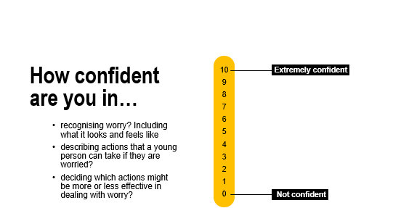
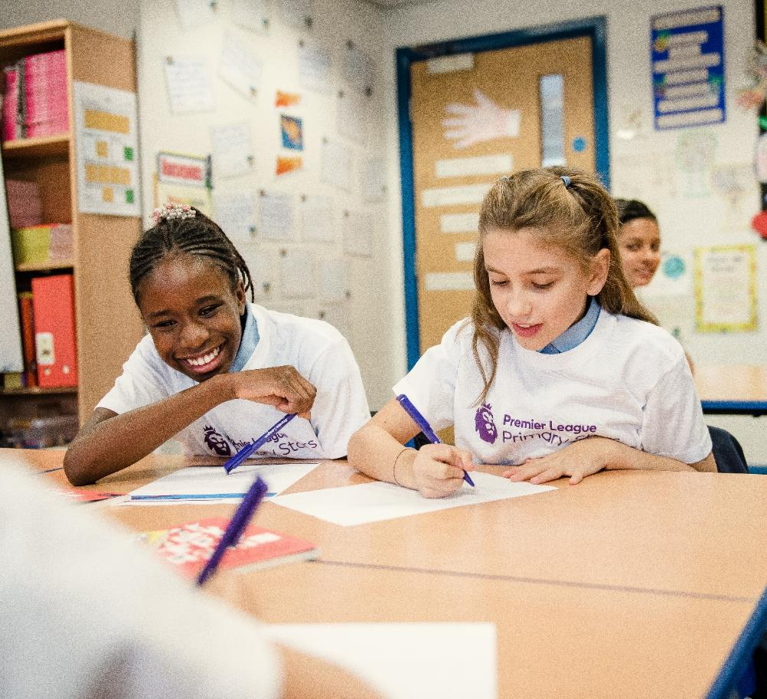

Your task:
Using the confidence scale to describe the key terminology:
- Discrimination
- Inclusion
What do they mean?
How do they make people feel?
Use drawings and writing to explain your ideas.
Notes:
Delivery tips
To ensure a true picture of the pupils’ current knowledge and understanding, this activity has to be completed by pupils without any prior input on the meaning of the words from the teacher or other adults.
Pupils should work individually using A4 paper or their usual workbooks, or in groups of three or four using a piece of flipchart paper to record their responses. This can be done as either or both drawings and writing.
Use this baseline assessment to gauge understanding and adapt teaching as necessary.

Slide 14
Following this activity, you will be able to:
explain what discrimination is
describe the feelings associated with discrimination.

Slide 15
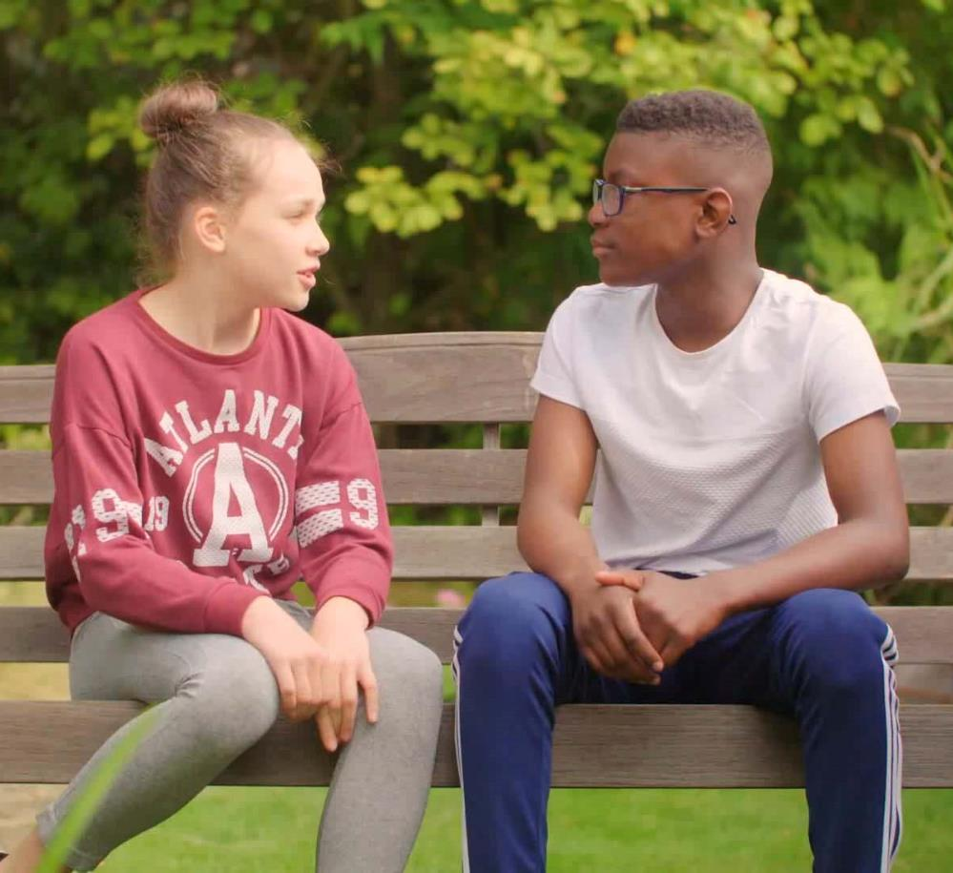


Watch this film about discrimination and inclusion.
Think about:
what you feel about discrimination.
Notes:
Delivery tips
Play the film, which has a pause point at 1 minute 11 seconds - ask pupils what think and feel about discrimination.
Facilitate a whole class discussion about the discrimination described in the film:
What happens?
How can it make people feel?
Using the film as a stimulus enable the pupils to name different types of discrimination they have heard of, for example: gender, age, ability/disability, racism (ethnicity, language, religion), height and sexual orientation – ensure ground rules are adhered to.
Briefly discuss how inclusion differs to discrimination.

Slide 16
Main activity: Discrimination and inclusion
Activity summary
In the following activities, pupils look at the differences between discrimination and inclusion in more detail and the effects on people’s wellbeing. They also consider how to challenge discrimination and seek advice.
Approximate time required
30 minutes
Additional resources required
A4 plain paper/flipchart paper
Pens/pencils

Slide 17
Following this activity, you will be able to:
recognise when behaviour and language is inclusive or discriminatory
describe the associated feelings
identify ways to challenge discrimination and get help and support.

Slide 18
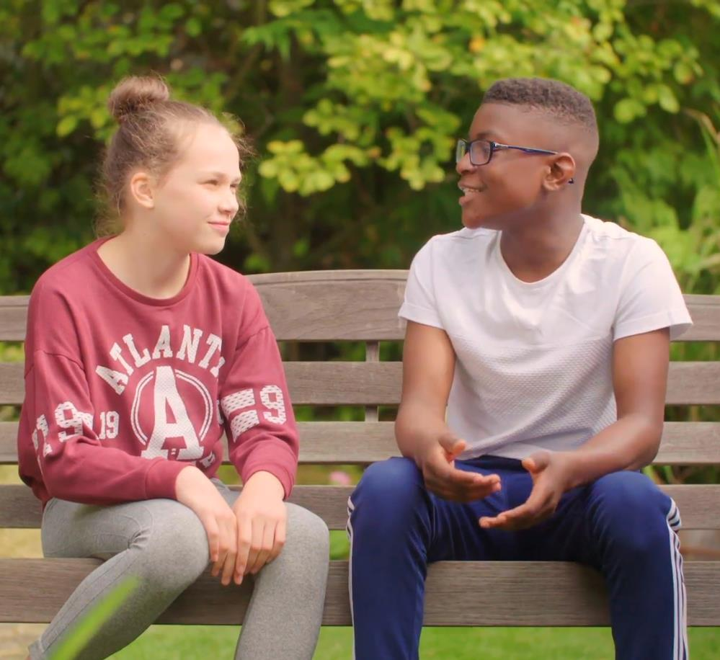

What do discrimination and inclusion mean?
discrimination | Treating someone unfairly
inclusion | Including everyone, whoever they are
Notes:
Delivery tips
Recap with the pupils what is meant by the words discrimination and inclusion using the given definitions.
Alternatively, pupils work in pairs, groups or as a whole class to write a clear definition of each of the words. Compare with each other and the definitions above.

Slide 19
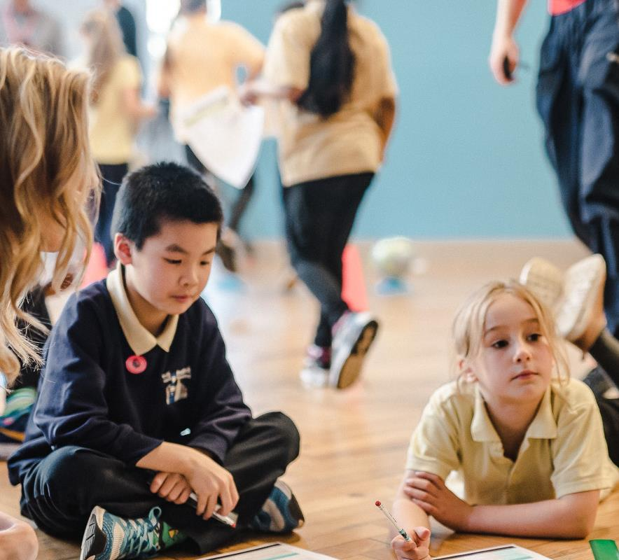
Your task: Decide which of these scenarios are discrimination and which are inclusion.
Everybody is playing together.
Only people wearing blue socks can join in.
The after-school sports club is open to everyone.
The red team always gets to go first.
The girls are not allowed to play football.
There are stairs and a ramp up to the sports centre entrance.
Only tall people can try out for the football team.
Everyone is welcome at our school.
Notes:
Delivery tips
Pupils work in pairs or groups to discuss and sort the statements. Pupils should explain their reasoning. Then, pupils discuss which statements feel better and what would be the consequence and effects of the examples. Take feedback.
Some pupils could go on to change the discriminatory sentences to be inclusive – writing these in their workbooks or on a piece of paper.
Answers:
Everybody is playing together: inclusion
Only people wearing blue socks are allowed to join in: discrimination
The after-school sports club is open to everyone: inclusion
The red team always gets to go first: discrimination
The girls are not allowed to play football: discrimination
There are stairs and a ramp up to the sports centre entrance: inclusion
Only tall people can try out for the football team: discrimination
Everyone is welcome at our school: inclusion

Slide 20
Lesson 2

Slide 21
Watch this film about discrimination and inclusion.
Notes:
Watch stimulus for recap.

Slide 22
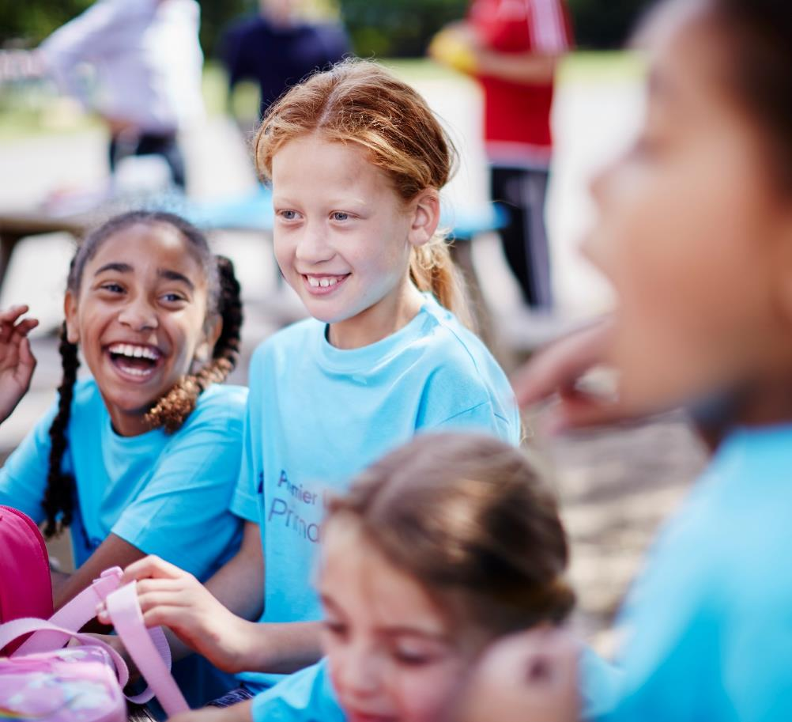
How does it feel to be included?
Imagine a group of children playing.
What words and phrases would they use to be inclusive?
Notes:
Delivery tips
Using the film as a stimulus, talk about what it looks and feels like to be included; what words or phrases might someone who is being inclusive use? Record pupils’ responses. Examples of inclusive vocabulary that can be used as language prompts:
“There’s no reason why he/she can’t join us.”
“He/she can do it just as well as anyone else.”
“Would you like to play with me/us?”
“You’re really good at that, could you show me how to do it?”
Working in small groups, pupils explore through role-play the behaviour, actions and words of someone or a group of people who are being inclusive.

Slide 23
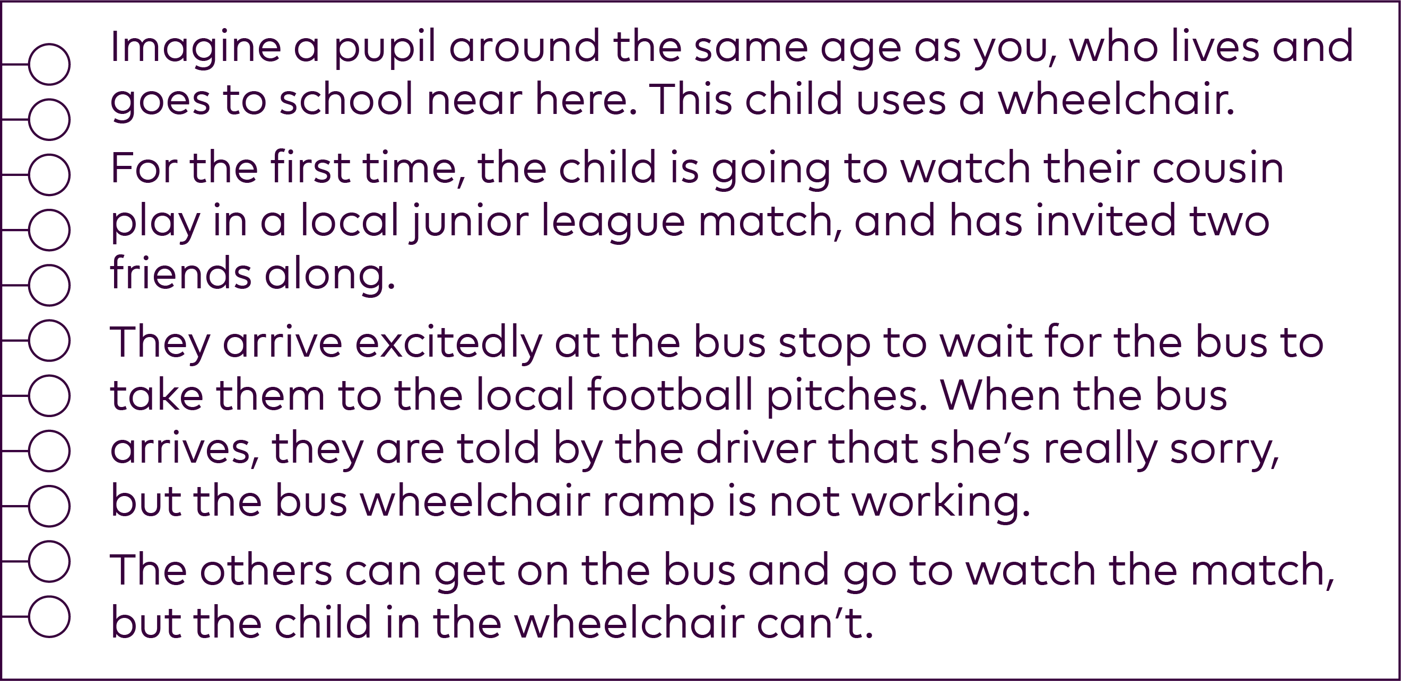
Notes:
Delivery tips
Read the scenario aloud to the pupils. Ask the pupils to discuss with a partner and explain what is happening (the child in the wheelchair doesn’t have the same opportunities as the children who aren’t). Display the next slide for pupils to consider the questions.

Slide 24

Think about the scenario and then answer the questions:
Do you think it’s fair?
What might the child in the wheelchair be thinking and feeling?
What might his or her friends be thinking and feeling?
What should they say to the bus driver?
What should they do?
Are there any laws which protect against discrimination?
Notes:
Facilitate a discussion about the scenario – as a whole class or with pupils working in groups. Use the questions as prompts to lead the discussion.
The Equalities Act (2010) protects people against discrimination. It sets out the duty to make reasonable adjustments for disabled people.
Ensure pupils are aware that they should always tell a trusted adult (parent or trusted adult at school) if they experience discrimination, if they are upset or worried about something, and that in this example, adults are best placed to follow it up.
Create a cartoon or write a letter/email to the perpetrators, explaining to them that they are discriminating against the person in the film. It should include the potential consequences of discrimination on themselves and on the young person. Suggest ways they could be more inclusive and why we should all work towards this.

Slide 25
Plenary activity: Sentence starters
Activity summary
Pupils have a chance to individually reflect on ways to help people feel included and the importance of inclusion.
Approximate time required
10 minutes
Additional resources required
none

Slide 26
Following this activity, you will be able to:
give examples of inclusive behaviour to challenge discrimination
explain why this is important.

Slide 27
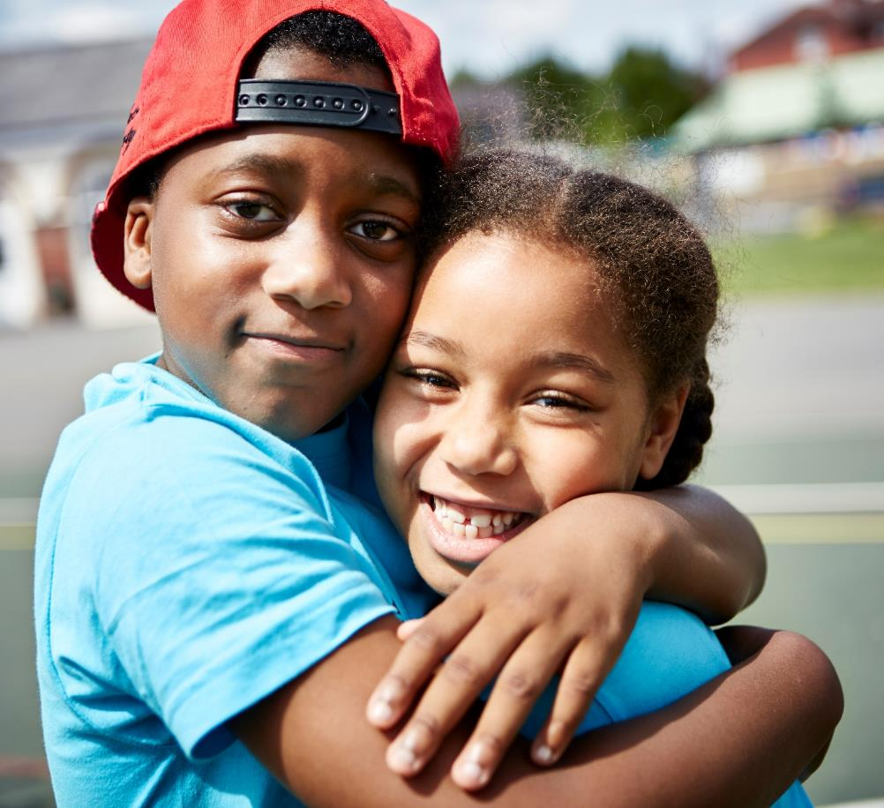
Your task:
Complete these sentence starters.
We can include everyone by…
Making everyone feel included is important because…
Notes:
Delivery tips
Pupils complete the sentence starters (pairs discuss and then share with the class) or pupils record individually in their books.

Slide 28
Closing/assessment activity:
Draw and write
Activity summary
Pupils return to their starter activity and add to or amend their initial thoughts and ideas to demonstrate a change or consolidation of their thinking and progress over the lesson.
Approximate time required
5–10 minutes
Additional resources required
Pupils’ original baseline/starter work
Coloured pens/pencils

Slide 29
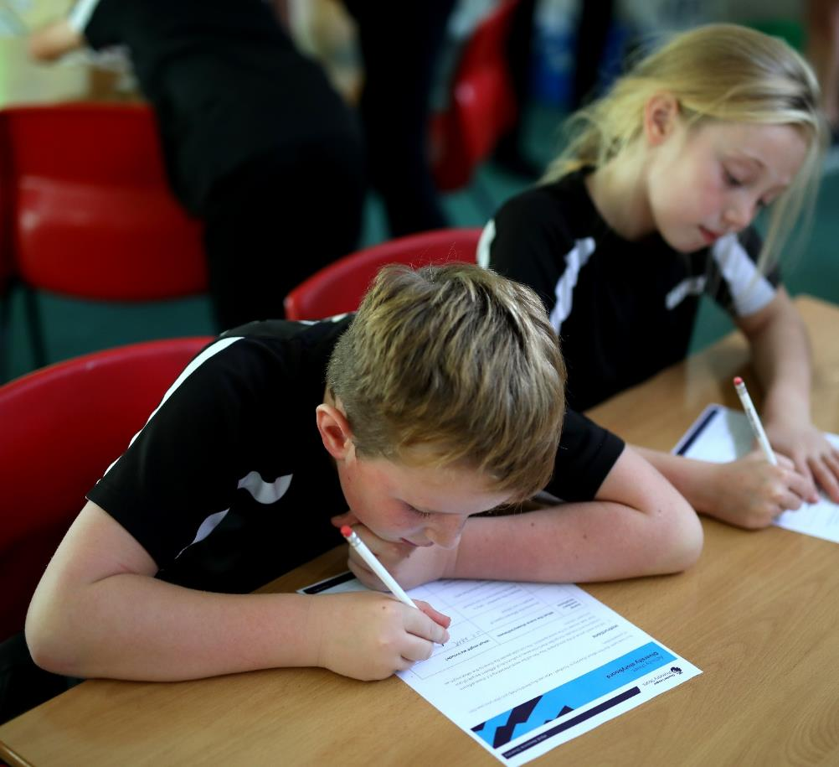
What do discrimination and inclusion mean to you?
Go back to your Draw and write starter activity.
Is there anything you would change? Is there anything you would add?
Use a different coloured pen or pencil (or pictures from newspapers and magazines) to show how your ideas have changed.
Notes:
Delivery tips
Remind the pupils of the starter activity and give them back their original or group work. Give the pupils a short amount of time to add to or amend their work.

