Slide 1
Following this activity, you will be able to:
challenge assumptions about ‘male’ and ‘female’ qualities, skills and attributes

Slide 2






Your task:
Draw a picture of one of these people:
footballer
ballet dancer
swimmer
gymnast
runner
Around the outside of your picture, write some words that describe the person you have drawn (e.g. strong, fit, flexible etc.)
Notes:
Delivery tips
When pupils have finished their drawings and writing, ask for some volunteers to show examples of what they have drawn, and explain their drawing and descriptions.
Use the following questions to facilitate discussion:
What gender are the people in your drawings? (Ask for each of the different sports.)
Are there any sports where people have drawn mostly men, or mostly women? Why do you think this is?
Are there any sports where people have drawn both men and women doing the sport?
Note: you may want to link to the new No Room for Racism: Stereotyping pack and discuss any diversity of race as well as gender in the drawings: : https://plprimarystars.com/resources/nrfr-stereotyping

Slide 3
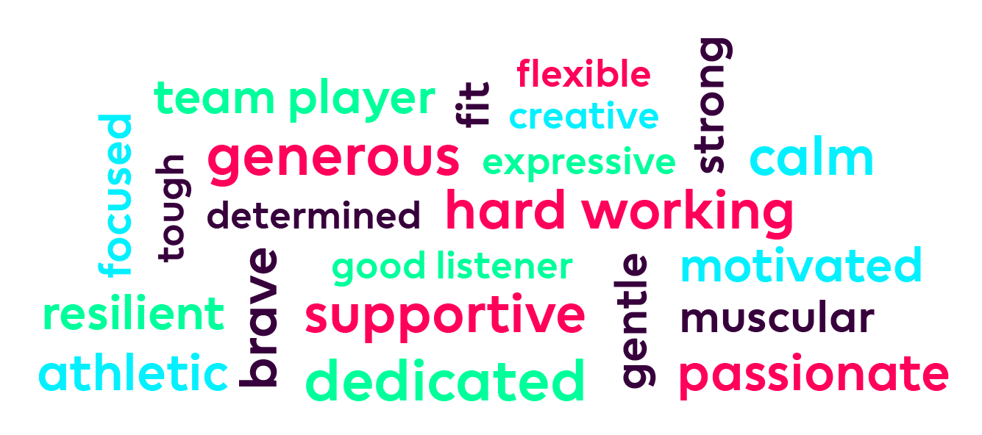

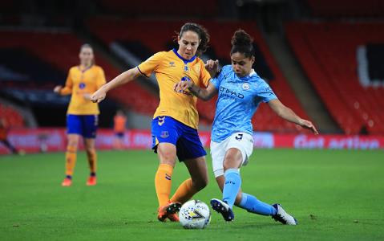
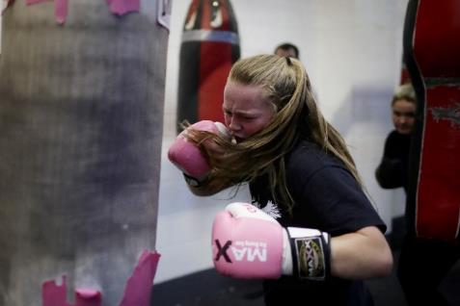
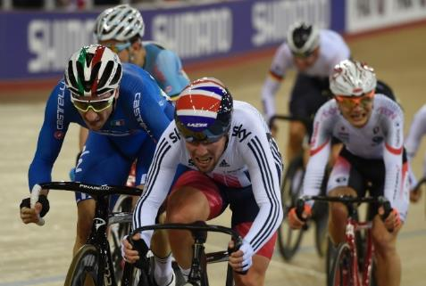
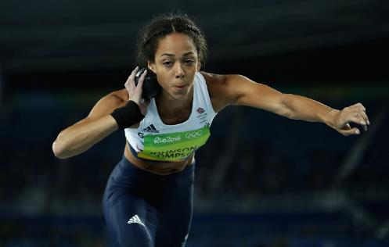
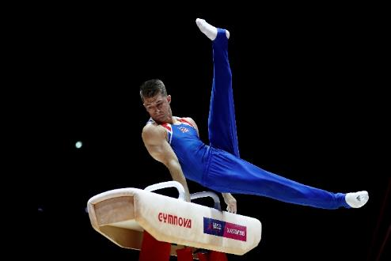
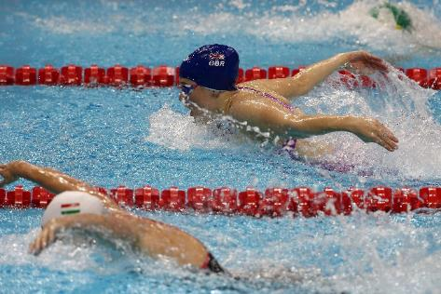
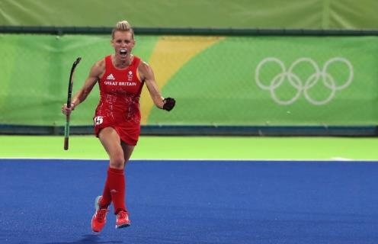
Notes:
Note: this slide is animated, view in presentation mode to display animation.
Delivery tips
Show pupils the images of different athletes. Are there any surprises?
Click on any image and the essential qualities and attributes needed for all the sports will appear.
Are there any words that people usually associate with men, or with women?
Looking at the athletes, are people right to make these assumptions?
Words: passionate, dedicated, calm, fit, athletic, muscular, resilient, generous, expressive, determined, hard working, good listener, gentle, flexible, creative, team player, supportive, focused, tough, motivated, strong, brave

Slide 5
Teacher guidance
The first part of this activity involves sorting cards into either male or female attribute piles. This is to highlight that the notion of something being exclusively seen as male or female is inaccurate and damaging, and does not include people who may not identify as either male or female.
As part of the discussion, remind pupils that people are individuals: not all girls are the same, nor are all boys, and individuals will enjoy different things. Also, some people may not feel that they are either a girl or a boy, and that’s also ok.
In the second part of the activity, a third option is given for the card sort, which could also lead to discussion about people who don’t identify as male or female.
Notes:
Delivery notes
The definitions below may be helpful for teachers:
Gender Identity: a person’s internal sense of their own gender, whether male, female, non-binary, or something else.
Non-binary: an umbrella term for a person who identifies outside of the ‘gender binary’, (in other words, outside of ‘male’ or ‘female’).
Trans: an umbrella term to describe people whose gender is not the same as, or does not sit comfortably with, the sex they were assigned at birth. Trans people may describe themselves using one or more of a wide variety of terms, including (but not limited to) transgender, cross dresser, non-binary, gender queer
Definition of trans for younger pupils: ‘Babies are given a gender when they are born. Trans is a word that describes people who feel the gender they were given as a baby doesn’t match the gender they feel themselves to be, for example someone who is given the gender ‘boy’ but doesn’t feel that way.’

Slide 6
Following this activity, you will be able to:
describe examples of gender stereotyping
challenge assumptions about what people enjoy doing based on their gender
identify damaging effects that gender stereotyping, and stereotyping in general, can have on individuals and society.

Slide 7
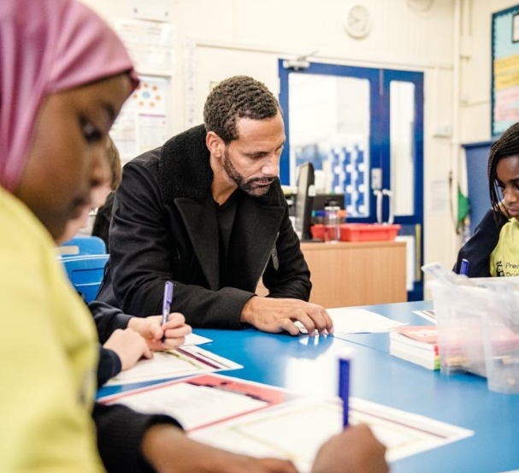
Card sort
Your group has a set of cards. Turn over one card at a time, then decide if it should go in a ‘Girls’ or ‘Boys’ pile.
Now do the activity again, but this time make three piles: ‘Girls’, ‘Boys’, ‘Anybody’.
Have you sorted the cards differently this time?
Notes:
Delivery tips
Share the ‘Boys and girls’ cards with groups of pupils.
Reveal the first part of the activity. Tell groups that everyone should discuss and agree where each card should go.
After groups have finished, discuss where they have put their cards. Challenge their thinking using the following to help:
Why have you put particular activities in particular piles?
Do the piles feel correct?
Were there any disagreements?
After the discussion, reveal the second part of the activity and ask groups to sort the cards again. Discuss if they have placed them differently following the discussion.
Did they find this activity easier or harder than the first?
Challenge pupils by asking them why they think that making these kinds of assumptions about what boys and girls do and prefer is wrong. How can judgements like these harm people?

Slide 9
Teacher guidance
Before this activity it’s important to ensure that pupils are clear what ‘gender stereotype’ means. You may wish to have an introductory discussion about what they have learned so far from other activities and collect a bank of words and phrases as a class. This will also help you assess their understanding.
Definitions you could use:
‘the ways that we expect people to behave in society according to their gender, or what is commonly accepted as ‘normal’ for someone of that gender.’
A gender stereotype is when people are told they act in certain ways, or do or believe certain things, just because of their gender e.g. ‘girls like pink’; ‘boys are good at football’. Gender stereotypes are harmful when they stop someone from achieving their potential, limit the jobs they can do or prevent them making choices about their lives.
You may also want to highlight that some people don’t identify as male or female, so for them gender stereotypes can be even more harmful.
The activity comes with some fictional examples of gender stereotyping that pupils might see around them. However, you may want to supplement these with real examples collected ahead of the lesson. These could be visual images such as pink and blue packaging for toys, images of billboard ads, front covers of books, newspaper headlines or magazine covers etc.

Slide 10
Following this activity, you will be able to:
identify examples of gender stereotyping
describe ways to help change people’s assumptions, language and behaviour to avoid gender stereotyping

Slide 11
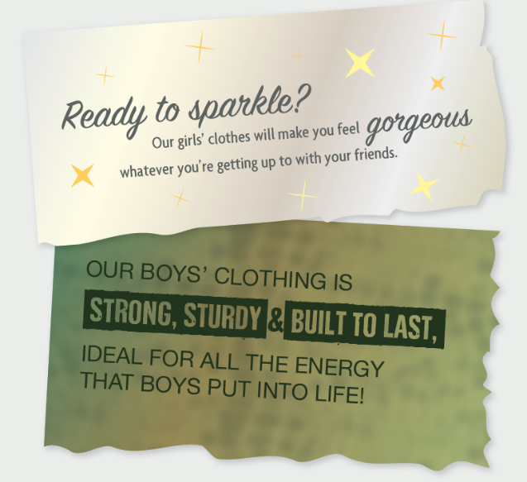
Stereotypes in the media
Look at the images and news headlines that your teacher gives you.
Would you say that any of these contain gender stereotypes?
How could these stereotypes be harmful to individuals or society?
Can you think of a way to change the images or the language to remove gender stereotypes?
Notes:
Delivery notes
Circulate the downloadable ‘Gender stereotypes around us’ examples.

Slide 13
Teacher guidance
Activity 5 contains two activities, A (slide 4) and B (slide 6), so you can choose the one you feel is most suited to your class, school or pupil need.
The template provided for activity A helps structure pupils’ thinking and observations, to alert them to subtler forms of stereotyping, such as book covers, display images, playground usage and language of people around them.
Both activity A and B could lead to an equally useful discussion of pupils’ experiences of gender stereotyping, or aspects of school life where some people may not feel included.
Notes:
Delivery tips
You may want to use Activity 5 alongside the No Room for Racism resource packs, which include discussions and activities about ways to recognise and challenge stereotyping when it occurs:
No Room for Racism: Stereotyping pack: https://plprimarystars.com/resources/nrfr-stereotyping
No Room for Racism: Racism and inclusion pack: https://plprimarystars.com/resources/nrfr-racism-inclusion

Slide 14
Following this activity, you will be able to:
identify examples of gender stereotyping
describe changes that can happen to avoid gender stereotyping and enable everyone to feel included.

Slide 15
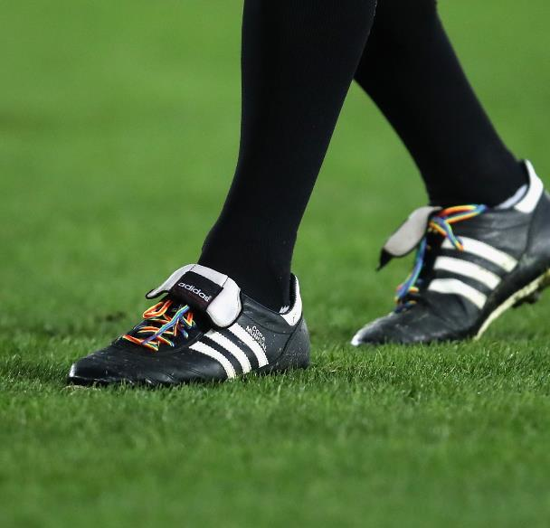
Activity A –Take a gender walk
In small groups, take a ‘gender walk’ around school. See if you can spot any examples of gender stereotyping, or where some children may not feel included. Use the recording template to help with your observations.
What is your school doing well?
Is there anything that it could change, or do better?
How could you take action to change things in school?
Notes:
Delivery tips
Activity A
To aid organisation, the downloadable ‘Gender walk template’ structures the activity to enable pupils to focus their observations and make suggestions for action.
Pupils could also be put into small groups and given a different space within school on which to focus, then share their observations as a class.

Slide 16

Extension – Take action!
Use your class findings from the gender walk to make an action plan:
What could be changed?
What can the school and your class do to make change happen?
What can you do as an individual to make change happen?
Notes:
Delivery tips
Extension to activity A
if pupils have identified examples of gender stereotyping, or gender disparity that they feel strongly should change, you could consider discussing these at a school council meeting or to take to SLT or governors, if appropriate. This work could help develop pupils’ understanding about how to be an active citizen.

Slide 17
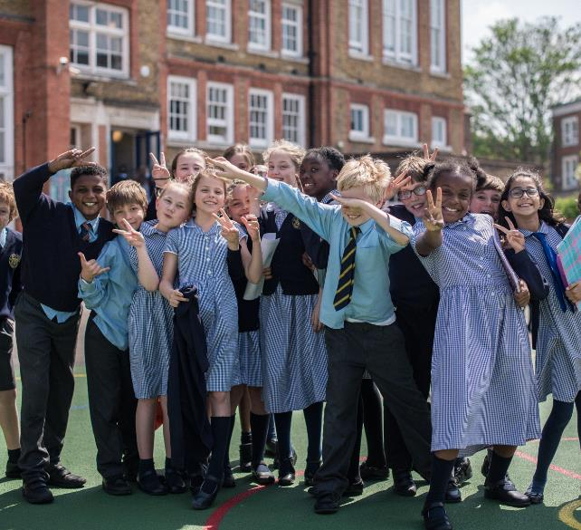
Activity B – Design a more inclusive school
Design a classroom or school and identify the areas where stereotypes might appear, or where some people may feel excluded.
For each area, list some things the school could do to make sure it is more inclusive and stereotype-free.
Notes:
Delivery tips
Activity B
Pupils could work in groups on this task to look at where gender stereotypes might appear in a classroom or school, or where some people might feel excluded e.g. dressing up corner, library book choices, in the playground, on posters or notices, people’s language or behaviour.
They should then indicate how these aspects could be addressed.
Activity 5 template B can be used to support this activity.

Slide 18

Extension – Take action!
Look out for other stereotypes outside school – things you see or hear when you’re out and about, watching TV, or on your journey to school.
Can you spot any examples of stereotypes, or where some people might feel excluded?
Talk about:
What needs to change to make these things more inclusive?
What could the school and your class do to help change happen?
What can you do as an individual to help change happen? (This is called social action).
Remember to make sure any social action is taken safely!
Notes:
Delivery tips
Extension to activity B
Encourage pupils to identify examples of stereotyping or where people might be excluded that they see and hear out of school, e.g. on TV, radio, internet or billboard ads, in shops or shop windows, in places they go such as leisure centres or the library, or things that they see or hear on their way to school.
Pupils could consider writing a letter to a relevant organisation, for example to the local council, a local business or a company, letting them know that they value inclusivity and diversity and asking them to think about diversity, celebrate different identities and take steps to promote inclusivity. This work could help develop pupils’ understanding about how to take social action and be an active citizen.
Note: Pupils should be reminded about ways to stay safe in their local community, and that they must talk to a trusted adult (e.g. parent, carer or teacher) before they take any kind of social action. Please ensure that the latest government guidance on the Coronavirus pandemic in your area is followed.

Slide 19
Notes:
Title slide

Slide 20
Teacher guidance
This activity introduces pupils to allyship and encourages them to think of top tips for being a good ally. It also helps them think about how to demonstrate allyship by making a pledge. It can be used alongside, or as an introduction to or extension of, the activities on allyship in the No Room For Racism - Stereotyping pack: https://plprimarystars.com/resources/nrfr-stereotyping
The activity also includes a simple take-home or extension task which pupils can do independently. You can also use this to promote discussion of ways we can all take action to make positive changes in our communities and the wider world.
Additional resources
Stonewall: Top tips for LGBT allyship in sport: https://www.stonewall.org.uk/top-tips-lgbt-allyship-sport
Notes:
Note: this is a hidden slide for teacher use only.

Slide 21
Following this activity, you will be able to:
identify examples of allyship
identify ways to be a good ally in different areas of life
create five top tips for being a good ally in school
create an ‘allyship pledge’ to demonstrate commitment to being a good ally.
Notes:
Delivery notes
The final outcome refers to the extension/take home activity on slide 9.

Slide 22
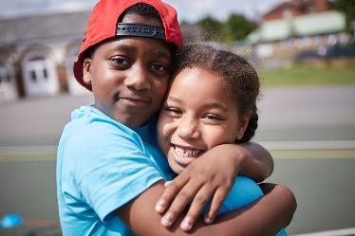
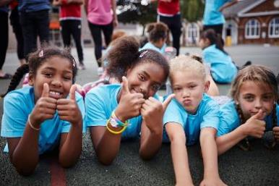
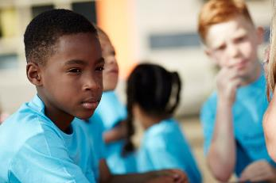
What makes a good friend?
Notes:
Delivery notes
Discuss what makes a good friend and make a class list. You might include things like:
Supporting each other, particularly if someone is feeling down or needs help
Sticking up for one another
Encouraging one another
Listening
Being trustworthy
Ask pupils to think about their friendships. Are they a good friend? Are their friends being a good friend to them?

Slide 23
Being an ally
Ally: someone who is willing to act with or for others to create equality.
Being an ally is like being a good friend. Anyone can be an ally towards someone who is experiencing stereotyping or unfair behaviour, for example because of their gender or race.
Some Pride flags include the colours black and brown within the rainbow, to demonstrate allyship towards people of colour.
Can you think of anything you could say or do to show that you are an ally?
Notes:
Delivery tips
The No Room for Racism packs also contain activities and a film about allyship and can be used to support your teaching.
No Room for Racism: Racism and inclusion pack: https://plprimarystars.com/resources/nrfr-racism-inclusion
No Room for Racism: Stereotyping pack: https://plprimarystars.com/resources/nrfr-stereotyping
Ask pupils:
What is one thing you could say or do to show allyship?
Can you think of times when you could say or do these things?
How could you be an ally in these areas of your life?
At school
At home
With your friends
Playing or watching football

Slide 24
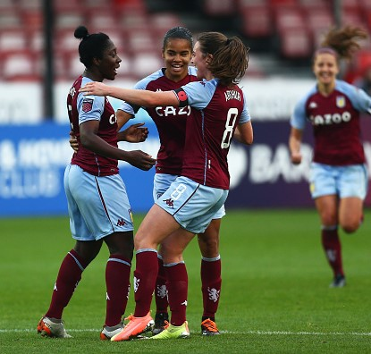
How can you become a good ally?
Anyone can be an ally.
Good allies try to understand other people’s struggles.
Allies use their voices to support friends who are experiencing unfair behaviour, for example because of their gender or race.
Allies speak out.

Slide 25
Allyship in football
Here is what some Premier League footballers have to say about allyship:
“When you’re in the team environment you want to stick up for your mates and make sure your mates are feeling OK. It is important to ask your teammates, how are you? It is important to talk.”
Adam Lallana, Brighton and Hove Albion
“Everything can help. Some people like a hug, other people some support or encouragement. Try to say something and make it stop, and then try to understand more about the situation.”
Divock Origi, Liverpool
“You see our changing room: it’s full of people from all over the world, but we are one as soon as we come into that changing room. I think it isn’t about being captain, it’s about being a friend.”
Conor Coady, Wolverhampton Wanderers

Slide 26

Top tips for being a good ally
Think of five top tips for being a good ally.
Display these in the class for everyone to see and show them to visitors to encourage them to be good allies too.
Notes:
Delivery tips
The ‘Top tips for being a good ally’ activity sheet can be used for pupils to write their top tips.
Pupils could come up with their own top tips in pairs or groups, then feed back for the class to choose a ‘final five’ to display.

Slide 27

My allyship pledge
What do you promise to do to be a good ally?
Use the Premier League values to create your own allyship pledge.
Be ambitious
My goal as an ally is to….
Be inspiring
I will set an example to my friends and family by…
Be connected
I will be a good classmate and teammate by…
Be fair
I will treat my friends fairly and equally by…
Notes:
Delivery tips
Use the class top tips to help pupils make their own ‘Allyship pledge’ using the activity sheet. Remind them that being a good ally helps to make a more fair and equal society for everyone.
Using the four Premier League values to help them structure their pledge, ask them to think about the things they could do or say to demonstrate that they are a good ally (you could also remind them of their ideas from slide 5). These could be displayed along with the Allyship Top Tips, or on an ‘Allyship pledge wall’ to demonstrate their promises to everyone. Alternatively, you could create and display a whole class pledge to refer back to throughout the year.

Slide 28
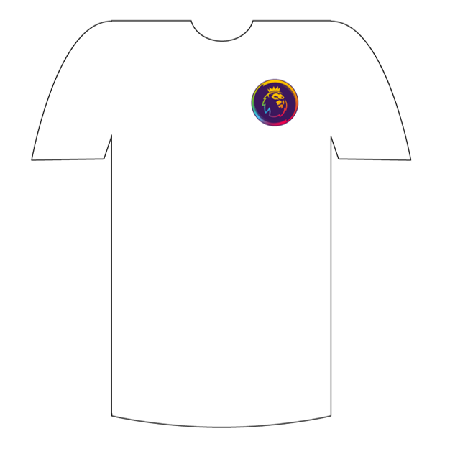
Extra time: Design a football shirt
Design a football shirt to celebrate being inclusive and welcoming
Make sure you incorporate a rainbow design!
Include a message on your shirt to encourage everyone to be a good ally
ADD YOUR MESSAGE HERE
Notes:
Delivery tips
Pupils can use the ‘Design a football shirt’ activity sheet which you can find in the ‘Extra time’ section of this pack: https://plprimarystars.com/resources/rainbow-laces
This could be used as an extension or take-home activity.
Pupils’ designs could be collected together to form a class display of rainbow shirts.
We would love to see and celebrate the tips, pledges and shirts that pupils create! Please email us at plprimarystars@premierleague.com or tweet @PLCommunities using #PLPrimaryStars

